Slide 1

WQD 7003 Data Analytics
CHAPTER 6 – DATA VISUALIZATION
Saw Shier Nee, Hema Subramaniam & Aznul Qalid Md Sabri
sawsn@um.edu.my , hema@um.edu.my, aznulqalid@um.edu.my
Dept. of AI, Fac. of Computer Science and IT, University of Malaya
Dept. of SE, Fac. of Computer Science and IT, Universiti Malaya

Slide 2

Outline
Data Visualization
Ineffective Visualization
Type of visualization
Tips and Tricks

Slide 3
Learning Outcomes
At the end of this lecture, student will be able to:
To understand the definition(s) of the visualization and interpretations of the notion.
To understand categories of visualization and application areas
To select and design effective data visualizations for data exploration and answer particular research questions.

Slide 4
Data Visualization
Is a methodology that allows for discovering or confirming a useful information about the data by constructing and examining the graphical output.

Slide 5
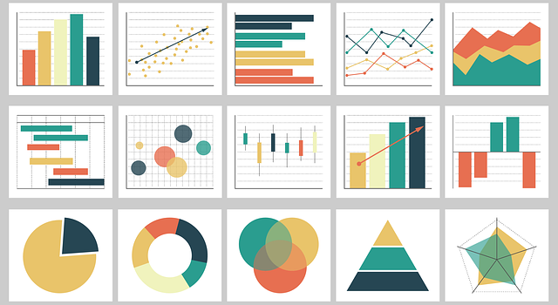
Data Visualization

Slide 6
Types of visualization
Communicate (Explanatory)
Present data and ideas
Explain and inform
Provide evidence and support
Influence and Persuade
Analyze (Exploratory)
Explore the data
Assess a situation
Determine how to proceed
Decide what to do

Slide 7
Challenges in Information Visualization
Which graphs should be used?
How to create these graphs?
How should these graphs be analyzed?
How to make graphs look good for publication / presentation?

Slide 8
Importance of Visualization
Human sight = primary resources for information understanding
Picture speaks thousand words.
The way of data visualization may affect decision making.
Understand how we see 🡪 better displays
Know your audience

Slide 9
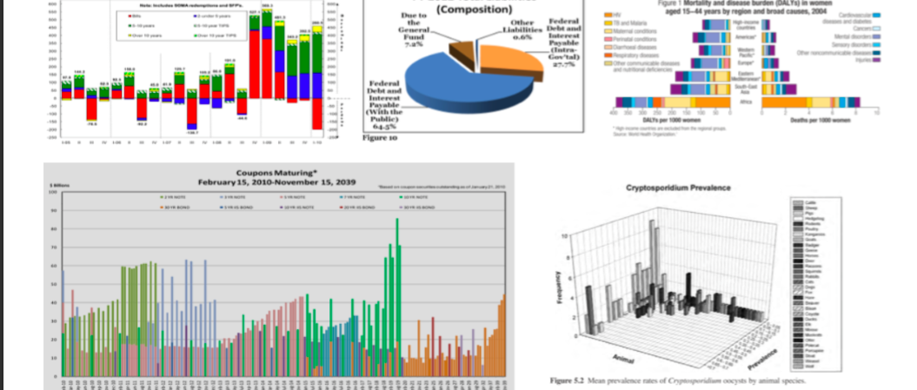
Ineffective Visualization - Complicated

Slide 10
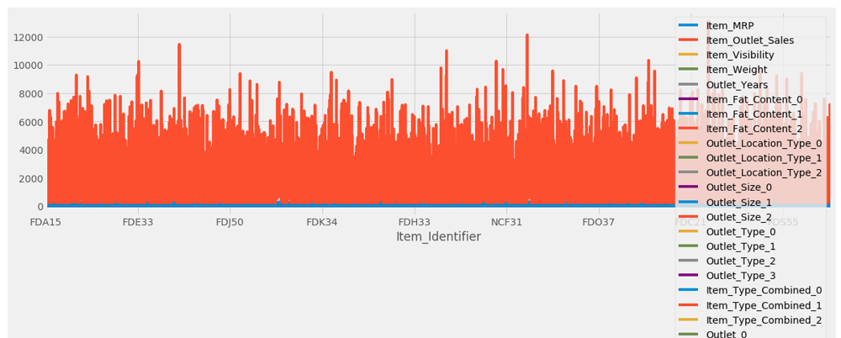
Ineffective Visualization - Example
What’s the main key message?

Slide 11
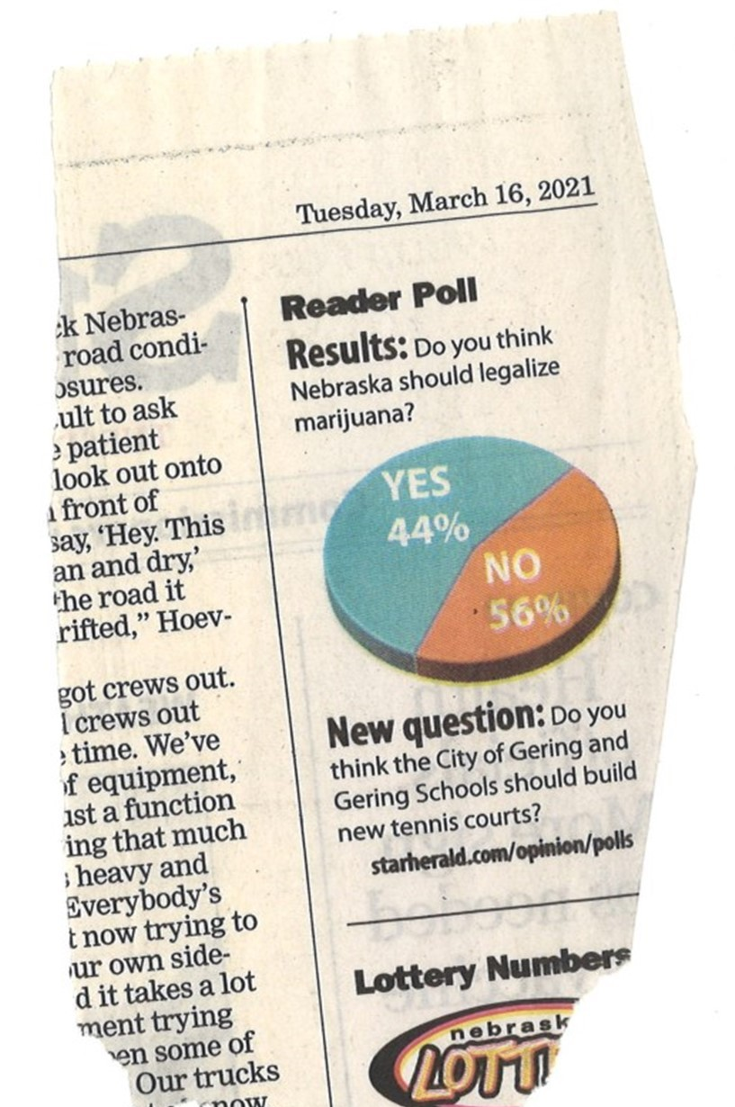
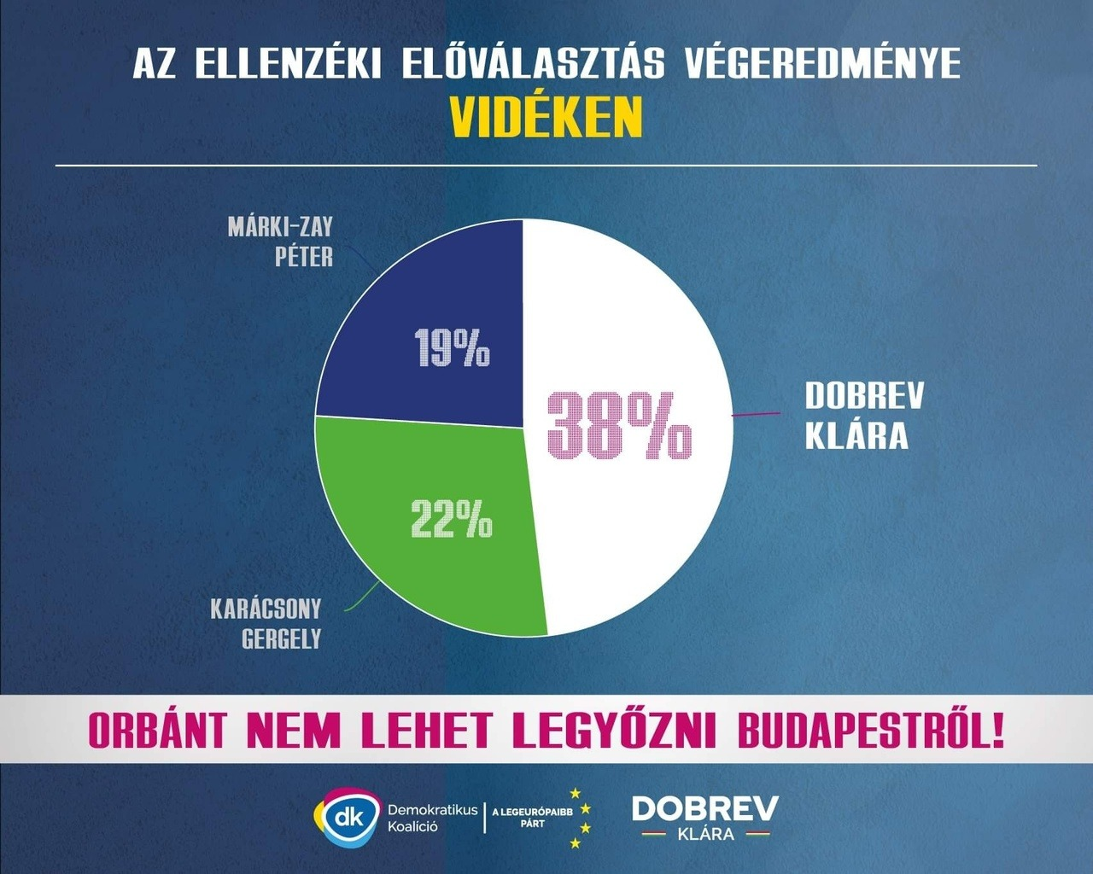
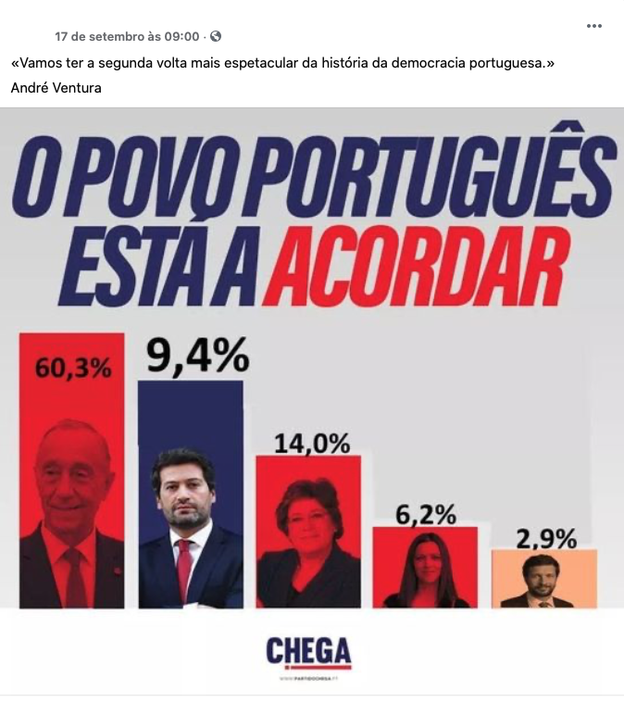
Ineffective Visualization - Example
What’s the problem?
https://viz.wtf/image/646651837987061760
https://viz.wtf/image/664318320965795840
https://viz.wtf/image/643484719208677376
Notes:
Misleading Information.

Slide 12
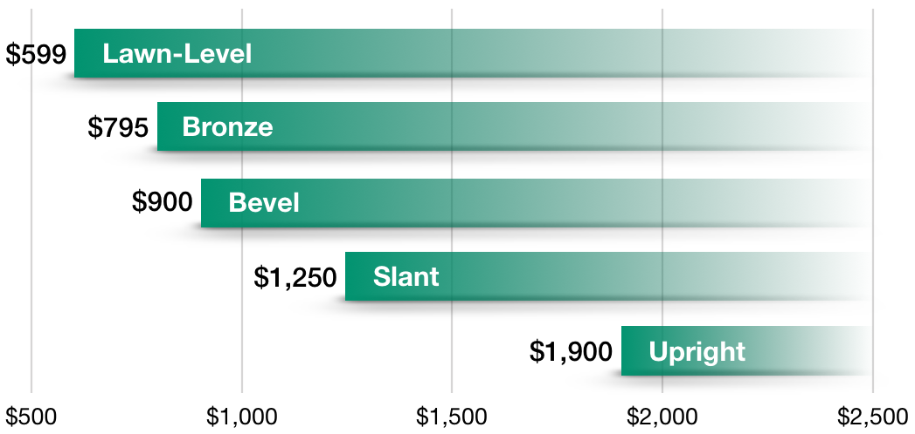
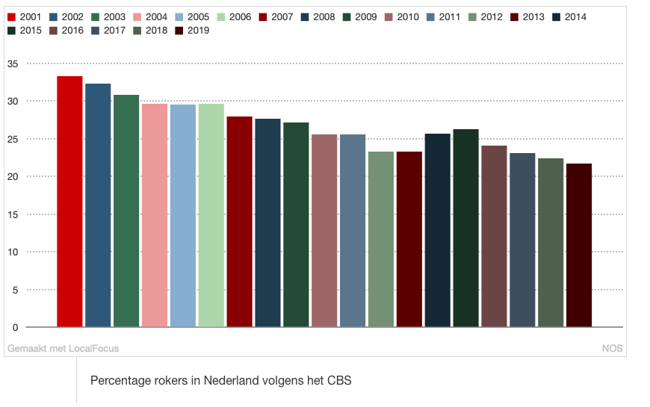
Ineffective Visualization - Example
What’s the problem?
https://viz.wtf/image/633790837442084864
https://viz.wtf/image/630887965804150786
Notes:
Left – bar chart height inappropriate. Right, axes labelling is missing, too many color.

Slide 13
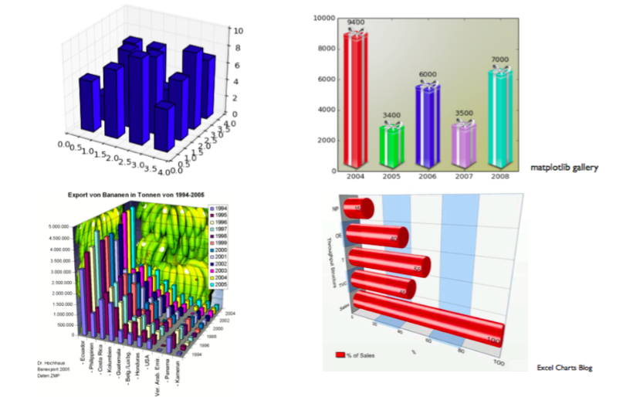
Data Visualization
Key important principle of visualization
Graphical Integrity
Simple & straight forward
Use color strategically
Bring out the key message visualization
Tell a story with data

Slide 14
Type of Graphs
Bar chart
Box Plot
Line graph
Pie Chart
Scatter plot
Histogram
Pair plot
Heatmap
Contour plot
Others…

Slide 15
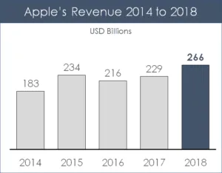
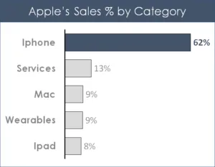
Data Visualization – Bar/Column Chart
Bar chart provides a visual presentation of categorical data.
https://nutsandboltsspeedtraining.com/powerpoint-tutorials/data-visualization/
Notes:
Compare different categories

Slide 16
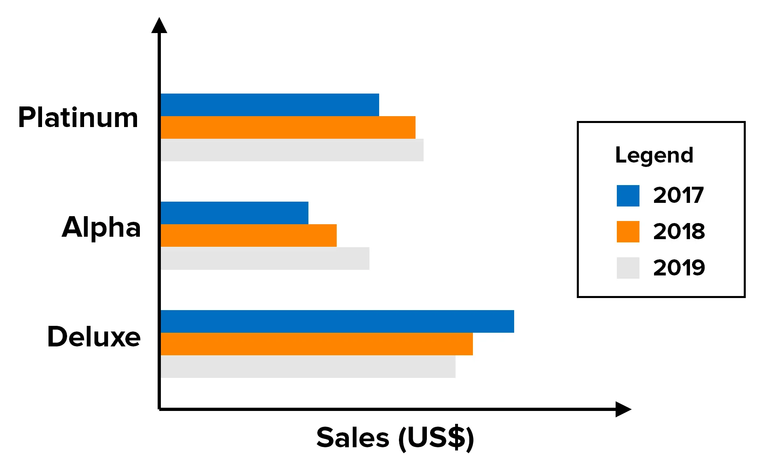
Data Visualization – Bar/Column Chart
Multiple series for comparison.
Notes:
Compare different categories

Slide 17
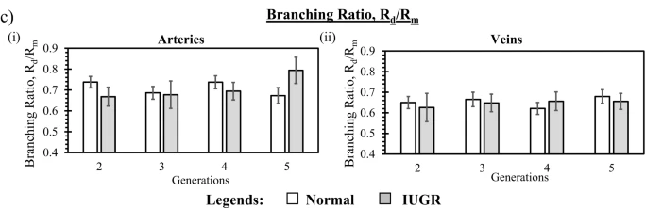
Data Visualization – Bar/Column Chart
Add in Error Bar
Saw et al. 2020, Altered Placental Chorionic Arterial Biomechanical Properties During Intrauterine Growth Restriction. Scientific Report. https://www.nature.com/articles/s41598-018-34834-5#Sec9
Notes:
Compare different categories

Slide 18
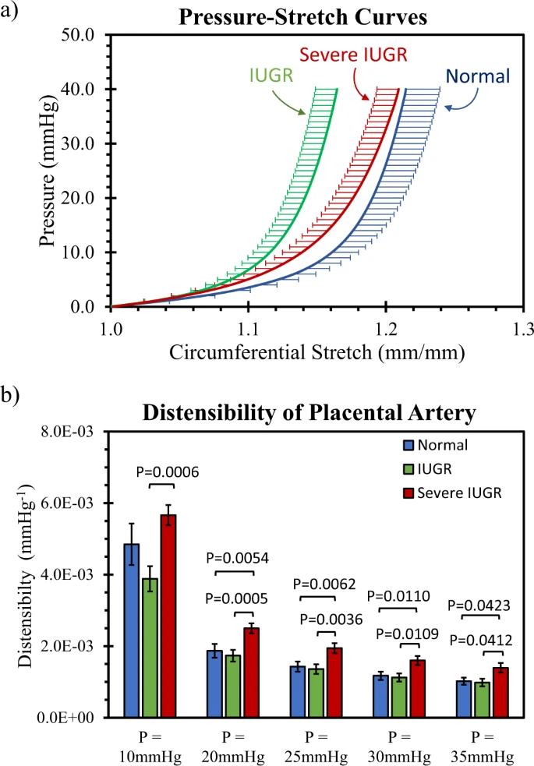
Data Visualization – Bar/Column Chart
Add in significance level
Saw et al. 2020, Altered Placental Chorionic Arterial Biomechanical Properties During Intrauterine Growth Restriction. Scientific Report. https://www.nature.com/articles/s41598-018-34834-5#Sec9
Notes:
Compare different categories

Slide 19
Data Visualization – Bar/Column Chart
Key message do we get from here
Severe IUGR have significantly higher distensibility than IUGR at all pressure (p<0.05)
Severe IUGR have significantly higher distensibility than IUGR at pressure higher than 10mmHg (p<0.05)
Distensibility decreases as pressure increases
Saw et al. 2020, Altered Placental Chorionic Arterial Biomechanical Properties During Intrauterine Growth Restriction. Scientific Report. https://www.nature.com/articles/s41598-018-34834-5#Sec9
Notes:
Compare different categories

Slide 20
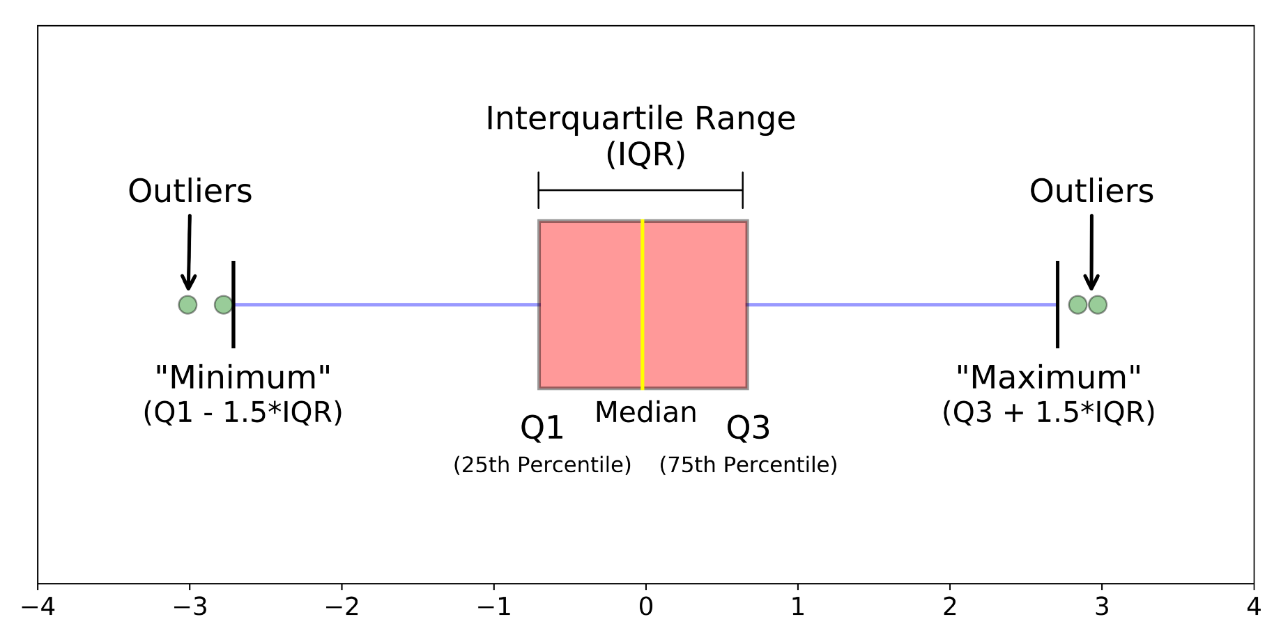
Data Visualization – Box plot
Demonstrate the locality, spread and skewness groups of numerical data through their quartiles.
https://towardsdatascience.com/understanding-boxplots-5e2df7bcbd51
Notes:
Compare different categories

Slide 21
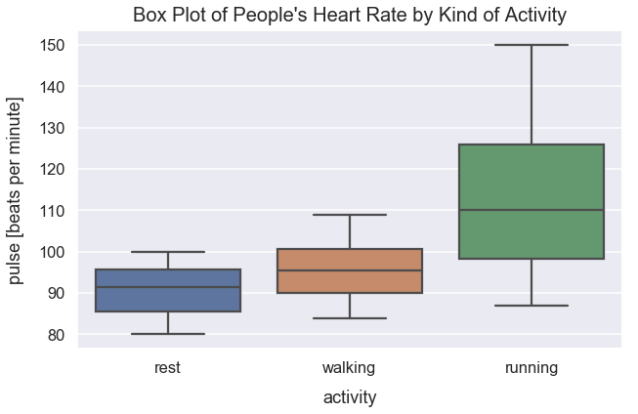
Data Visualization –Box plot
Wish to know the distribution of heart rate differs for people resting, walking and running.
Median heart increases by the level of exercise activity.
A significant jump in the median heart rate for those running from walking.
The distribution of recorded heart rates for those running varies much more than the distribution for those recorded after rest or walking.
The maximum recorded heart rate for running is 150 beats per minute.
Notes:
Compare different categories

Slide 22
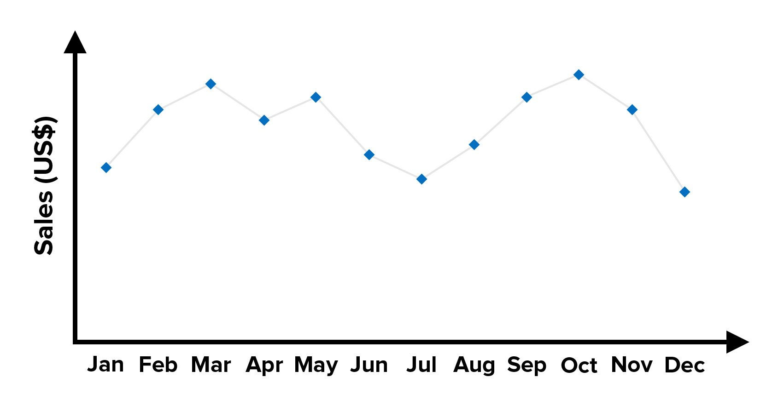
Data Visualization – Line Graph
Useful for showing trends and for identifying whether two variables relate to (or "correlate with") one another.
https://www.mindtools.com/pages/article/Charts_and_Diagrams.htm#:~:text=The%20word%20%22chart%22%20is%20usually,as%20shown%20in%20figure%201.
Notes:
Compare different categories

Slide 23
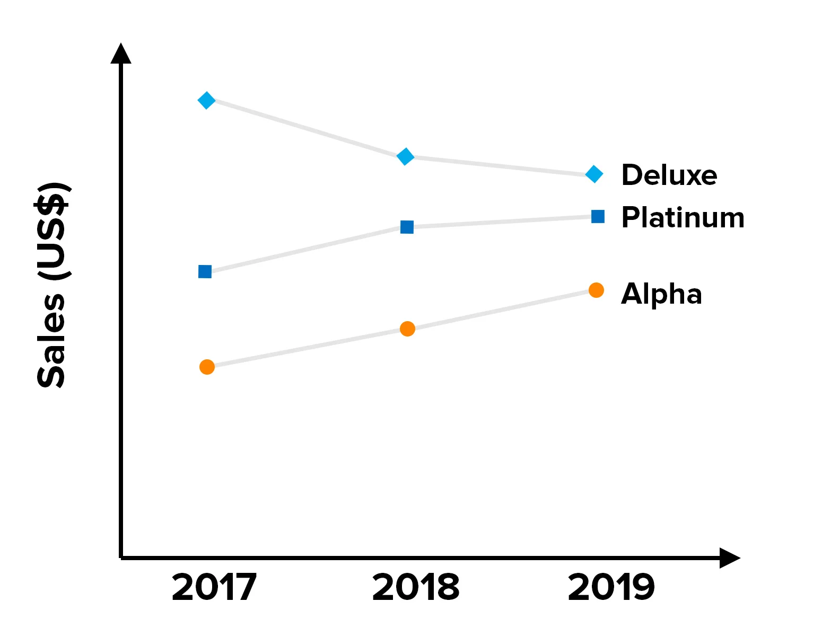
Data Visualization – Line Graph
Multiple series for comparison.
https://www.mindtools.com/pages/article/Charts_and_Diagrams.htm#:~:text=The%20word%20%22chart%22%20is%20usually,as%20shown%20in%20figure%201.
Notes:
Compare different categories

Slide 24
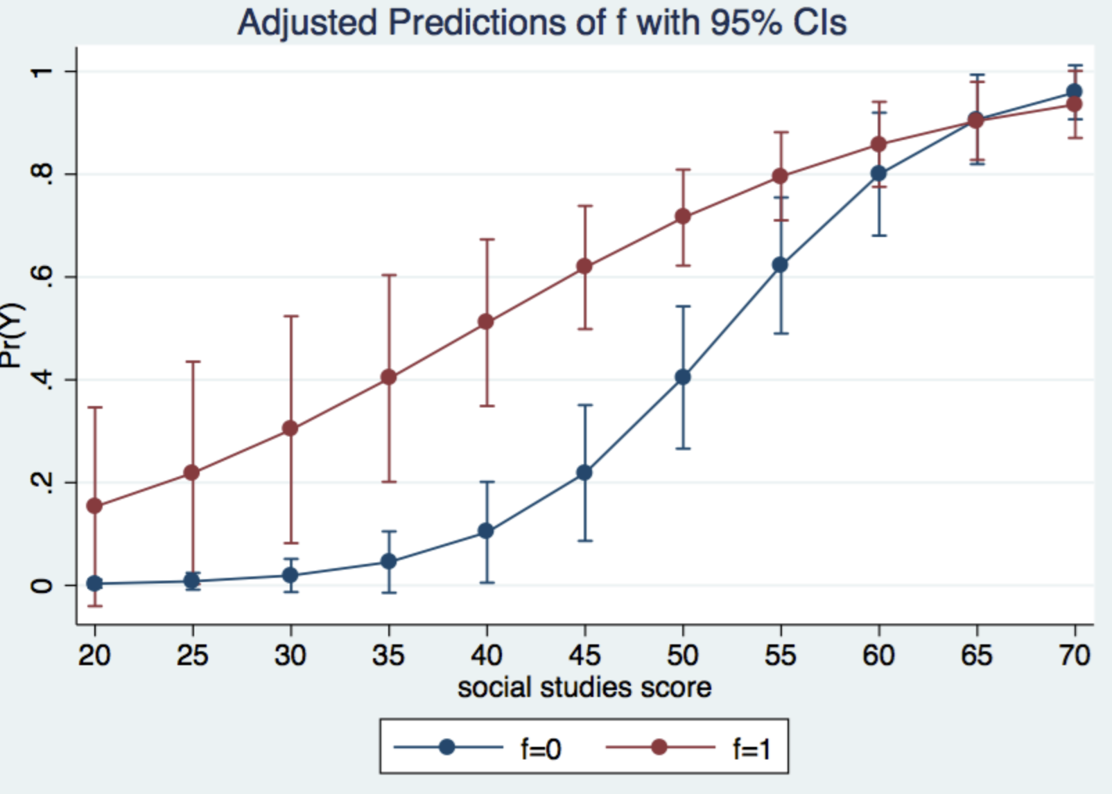
Data Visualization – Line Graph
Add in Error Bar
https://www.statalist.org/forums/forum/general-stata-discussion/general/1483503-how-to-add-tailor-made-error-bars-to-a-line-graph
Saw et al. 2020, Altered Placental Chorionic Arterial Biomechanical Properties During Intrauterine Growth Restriction. Scientific Report. https://www.nature.com/articles/s41598-018-34834-5#Sec9
Notes:
Compare different categories

Slide 25
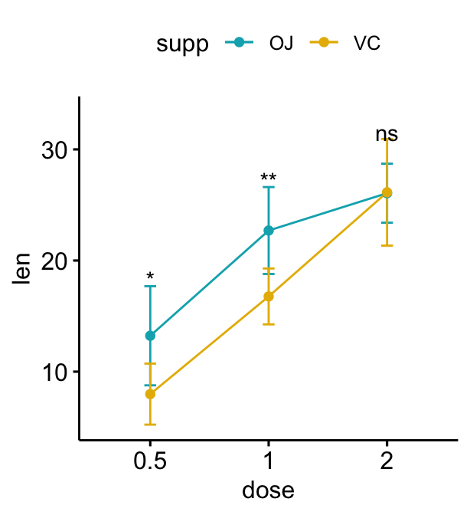
Data Visualization – Line Graph
Add in significance level
https://www.datanovia.com/en/blog/how-to-add-p-values-onto-a-grouped-ggplot-using-the-ggpubr-r-package/
Notes:
Compare different categories

Slide 26
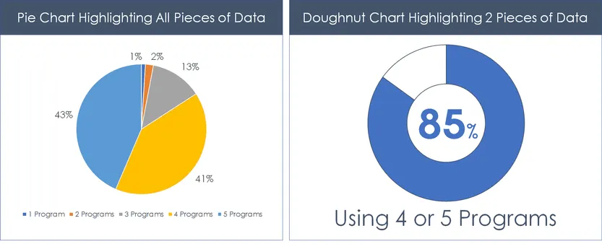
Data Visualization – Pie Chart
To show the proportional to the fraction of the whole in each category
https://nutsandboltsspeedtraining.com/powerpoint-tutorials/data-visualization/
Notes:
Compare different categories

Slide 27
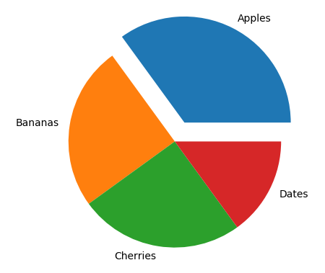
Data Visualization – Pie Chart
Tip 1:
Be careful not to use too many segments in your pie chart. More than six and it gets far too crowded.
Tip 2:
If you want to emphasize one of the segments, you can detach it a little from the main pie.
Limitation: Pie chart can mask the relative sizes and importance of the percentages. Consider whether a bar graph would better illustrate your intentions.
https://www.w3schools.com/python/matplotlib_pie_charts.asp
https://www.mindtools.com/pages/article/Charts_and_Diagrams.htm#:~:text=The%20word%20%22chart%22%20is%20usually,as%20shown%20in%20figure%201.
Notes:
Compare different categories

Slide 28
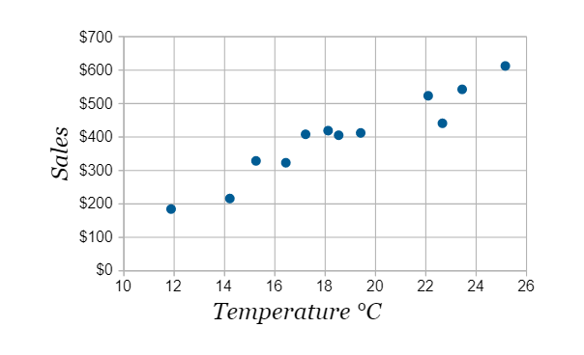
Data Visualization – Scatter Plot
To plot data points on a horizontal and a vertical axis in the attempt to show how much one variable is affected by another
https://www.mathsisfun.com/data/scatter-xy-plots.html
Notes:
Compare different categories

Slide 29
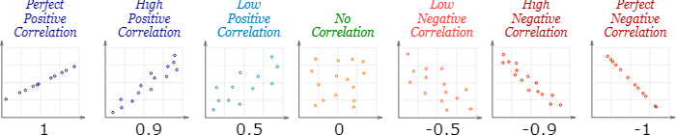
Data Visualization – Scatter Plot
Tell us about correlation
https://www.mathsisfun.com/data/scatter-xy-plots.html
Notes:
Compare different categories

Slide 30
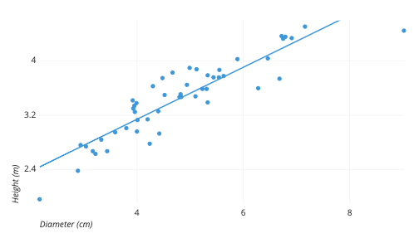

Data Visualization – Scatter Plot
Add a trendline to show the best fit line
https://chartio.com/learn/charts/what-is-a-scatter-plot/
Notes:
Compare different categories

Slide 31
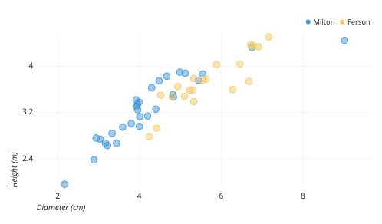
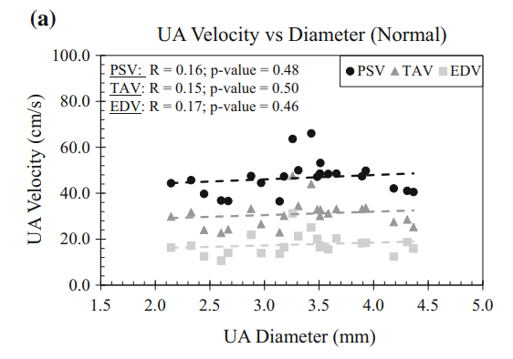
Data Visualization – Scatter Plot
Add a third categorical variable using different marker colors/types
Investigate the relationship of height and diameter for Milton and Ferson
Investigate the relationship velocity and diameter for Peak Systolic, Time-average and End-diastolic velocity
https://chartio.com/learn/charts/what-is-a-scatter-plot/
Notes:
Compare different categories

Slide 32
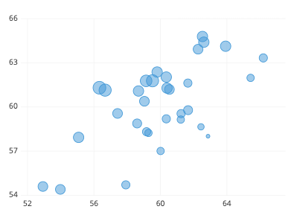
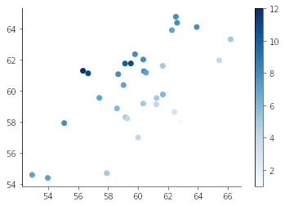
Data Visualization – Scatter Plot
Add a third continuous variable using different markers size / colors
Larger point indicates higher value
Darker color indicates higher value
https://chartio.com/learn/charts/what-is-a-scatter-plot/
Notes:
Compare different categories

Slide 33
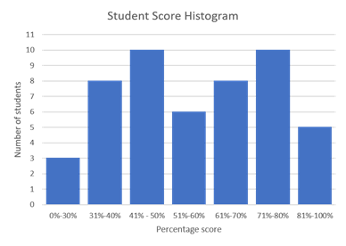
Data Visualization – Histogram
A graph that shows the frequency of numerical data using rectangles
To display a comparison of the distribution of certain numerical data in various ranges of intervals
https://www.tibco.com/reference-center/what-is-a-histogram-chart
Notes:
Compare different categories

Slide 34
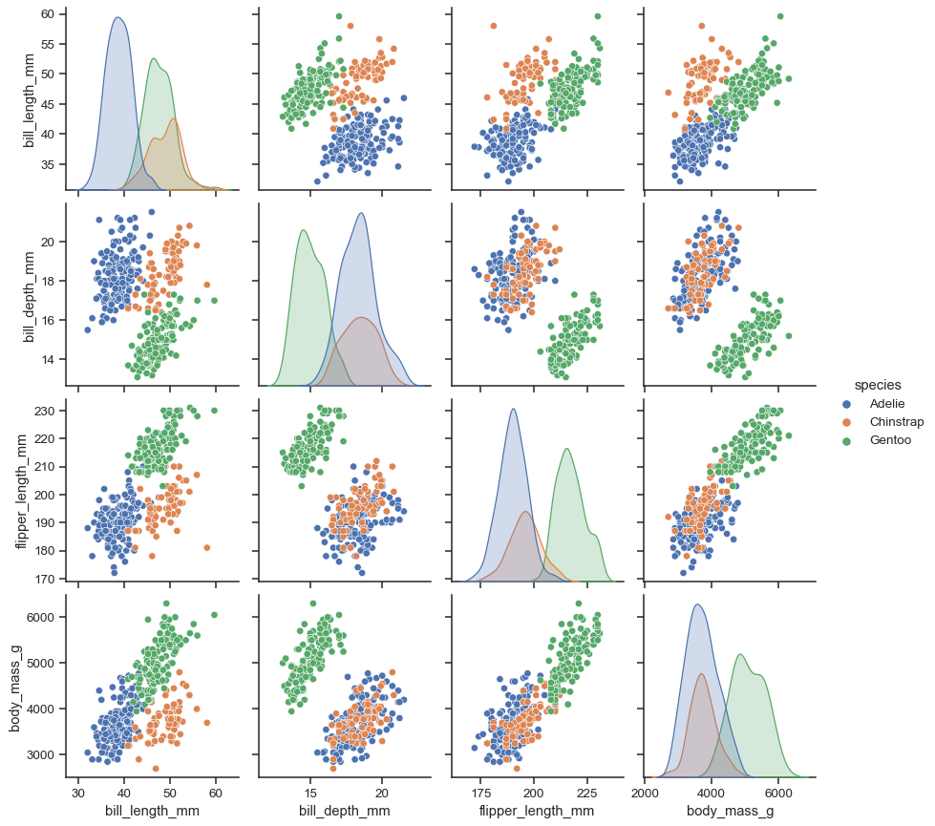
Data Visualization – Pair plot
Histogram
scatter plot
https://medium.com/@siddhardhan23/data-visualization-in-python-a90ddb706b23
Notes:
Compare different categories

Slide 35
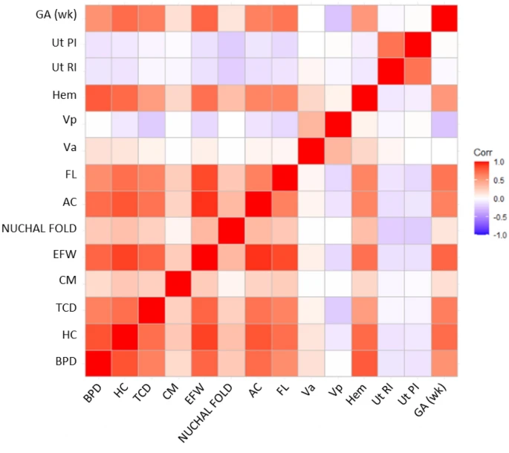
Data Visualization – Heatmap
https://www.nature.com/articles/s41598-022-07883-0#Sec2
Notes:
Compare different categories

Slide 36
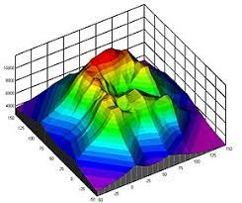
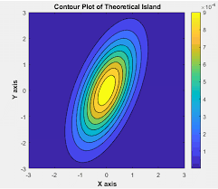
Data Visualization – Contour plot
Graphical technique for representing a 3-dimensional surface by plotting constant z slices, called contours, on a 2-dimensional format.
Notes:
IUGR – intrauterine growth restriction

Slide 37
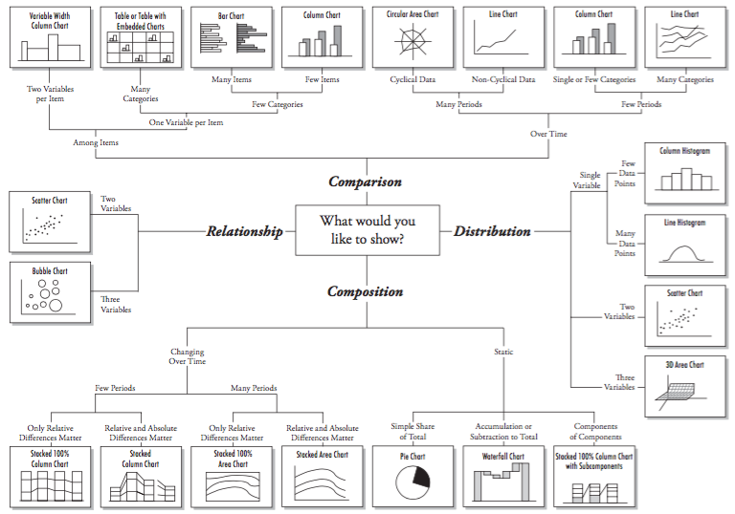
Data Visualization

Slide 38
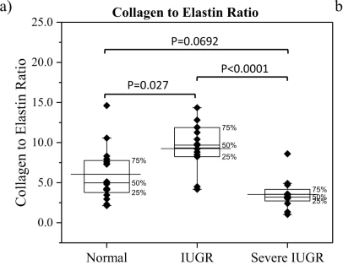
Data Visualization – Hybrid plot
Hybrid plots – box plot + point plot.
Saw et al. 2020, Altered Placental Chorionic Arterial Biomechanical Properties During Intrauterine Growth Restriction. Scientific Report. https://www.nature.com/articles/s41598-018-34834-5#Sec9

Slide 39
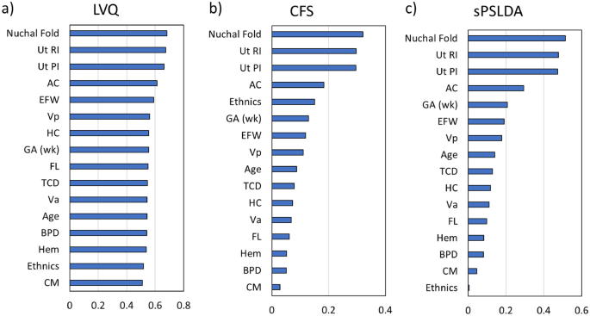
Tips and Tricks
Think of the key message.
Eg: Different feature importance methods consistently show that Nuchal Fold has the highest importance score.

Slide 40
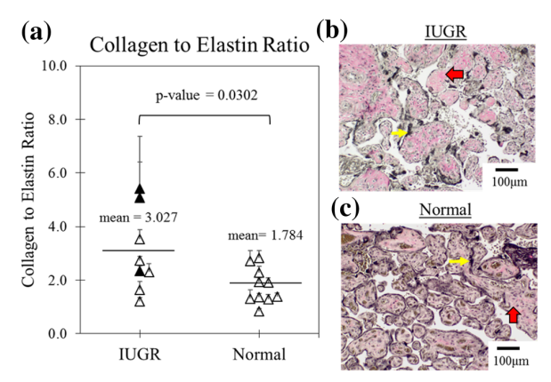
Tips and Tricks
Think of the key message.
Eg: IUGR has higher collagen to elastin ratio as compared to normal (p < 0.05)
https://link.springer.com/article/10.1007/s10439-018-2019-5
Notes:
IUGR – intrauterine growth restriction

Slide 41
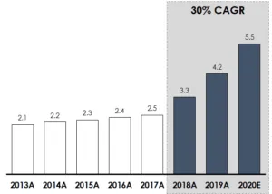
Tips and Tricks
Add rectangle to emphasis your main point
https://nutsandboltsspeedtraining.com/powerpoint-tutorials/data-visualization/
Notes:
IUGR – intrauterine growth restriction

Slide 42
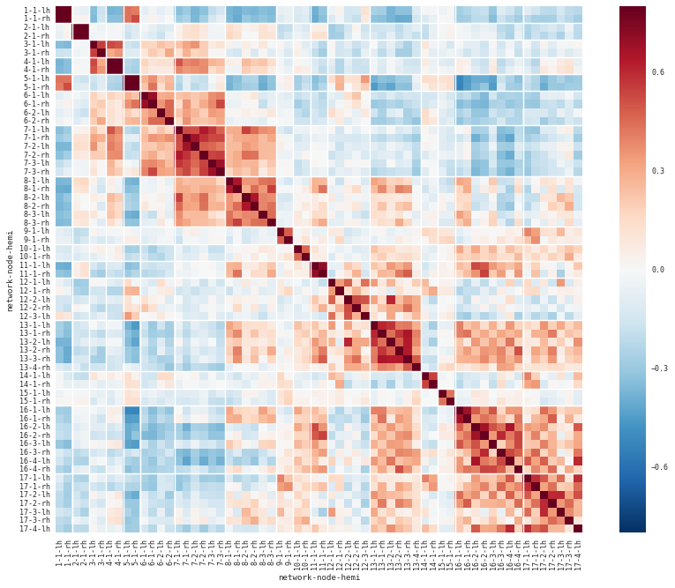
Is the following a good visualization?
Notes:
IUGR – intrauterine growth restriction

Slide 43
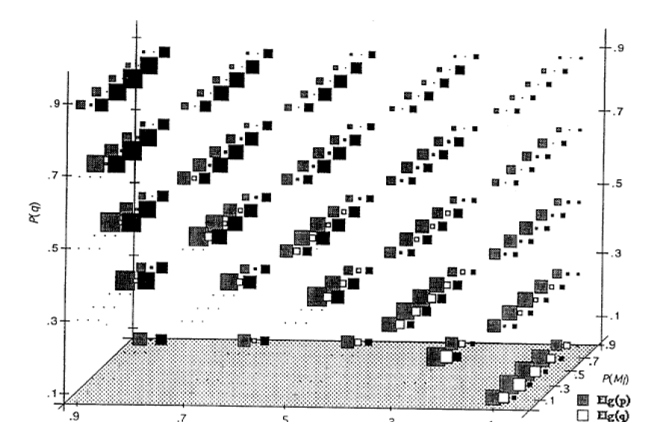
Is the following a good visualization?
Notes:
IUGR – intrauterine growth restriction

Slide 44
Related Videos / Reference
Data Visualization in Python
https://medium.com/@siddhardhan23/data-visualization-in-python-a90ddb706b23

